Slide 1

EPIC RPG
Adil Belim (92400584032)
Krupali Shah (92400584055)
Niyati Bhanani (92400584019)

Slide 2
Company Profile : GALAMINE AI
Galamine AI is a technology-driven company specializing in Artificial Intelligence solutions that help organizations automate processes, improve customer engagement, and enhance operational efficiency. The company develops AI-powered chatbots, virtual assistants, and customized digital solutions to support business growth and innovation.
Galamine AI operates under Amri Foundation, an organization committed to innovation, social impact, and sustainable development through technology and education.

Slide 3
Synopsis
Interactive text-based RPG game developed using Python
Supports user registration, login, and character creation
Features exploration, battles, rewards, items, and leveling up
Uses modular design for gameplay, inventory, store, and utilities
Stores player data using JSON-based file handling
Demonstrates core Python concepts like functions, loops, conditionals, and file handling
Runs on any system with Python, no graphics required

Slide 4
Introduction
Text-based RPGs (Role-Playing Games) are one of the earliest forms of computer games, built entirely through text prompts and user choices. These games are simple yet highly interactive, relying on decision-making rather than graphics

Slide 5
Objective
Implement user registration, login, and account management
Enable character progression with health, XP, level, and coin management
Design core game modules such as hunting, adventure, inventory, store, and profile
Lucy charm to boost your drops
Store and retrieve user data using JSON-based file storage
Provide a simple and user-friendly text-based interface

Slide 6
MODULES
User Management Module: Manages user registration, login, deletion, and data storage.
Game Mechanics Module: Handles core gameplay actions like hunting, adventure, rewards, and leveling.
Inventory Module: Displays and manages player items.
Profile Module: Shows player character details and statistics.
Store Module: Allows players to purchase items using in-game currency.
Craft module : to craft some items
Main Game Module: Controls overall game flow and user interaction.
Utils Module: Provides helper functions such as level calculation and item mappings. (more information available in documentation)

Slide 7
Menu Design
MENU
1. 🎯 Hunt
2. 🗺️ Adventure
3. 🧪 Heal using Life Potion
4. 🎒 View Inventory
5. 👤 View Profile
6. 🏪 Store
7. 🪵 Chop Wood
8. 🎁 Reward
9. 🛠️ Craft
10. 🗑️ Delete User
11. 🚪 Exit

Slide 8
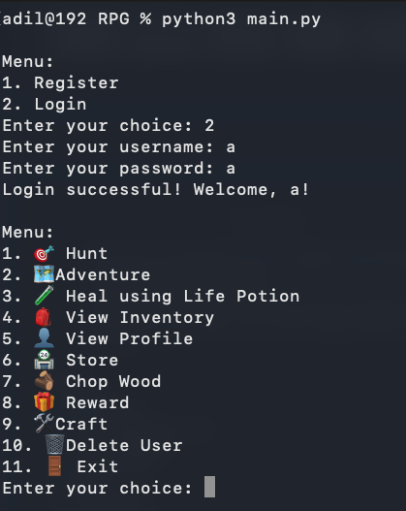
Screen Design

Slide 9
Test Case (Manual)
Test Case ID | Menu Option | Description | Expected Result
TC-01 | Register | Create a new user account | User account created successfully
TC-02 | Login | Login with valid credentials | User logged in
TC-03 | Login | Login with invalid credentials | Access denied
TC-04 | Hunt | Perform hunt action | XP, coins, and items updated
TC-05 | Adventure | Perform adventure | Health reduced or rewards gained
TC-06 | Chop Wood | Chop wood | Wood logs added to inventory
TC-07 | Store | Buy weapon or item | Inventory updated, stats affected
TC-08 | Craft | Craft Wooden Sword | Weapon crafted, attack increased
TC-09 | Craft | Craft Lucky Charm | Luck increased, cooldown applied
TC-10 | Heal | Use Life Potion | Health restored
TC-11 | Inventory | View inventory | Items displayed correctly
TC-12 | Profile | View profile | Player stats displayed
TC-13 | Reward | Claim reward | XP or coins added
TC-14 | Delete User | Delete account | User data removed
TC-15 | Exit | Exit game | Program terminates safely

Slide 10
Learning During Project Work
Learned how to break a big problem into smaller and easier parts
Got better at Python by actually using it in a real project
Understood how to save and load data using files (JSON)
Improved logic by fixing errors and testing the game again and again
Learned how different parts of a program work together
Got hands-on experience in planning and building a complete system
Felt more confident after successfully completing the project

Slide 11
Hardware Requirement
Hardware Requirement
Processor: Intel / AMD processor or equivalent
RAM: Minimum 2 GB (4 GB or more recommended)
Storage: 200–300 MB free disk space to support future game data, save files, logs, and feature expansions
Display: Terminal or console window
Input Device: Keyboard

Slide 12
Software Requirement
Windows: Windows 10 or later
Linux: Modern Linux distributions
macOS: macOS 11 or later

Slide 13
References
W3Schools, Python Tutorial.
Available at: https://www.w3schools.com/python/
Referred for understanding Python basics such as functions, dictionaries, loops, and file handling
EPIC RPG Wiki, EPIC RPG Game Guide.
Available at: https://epic-rpg.fandom.com/wiki/EPIC_RPG_Wiki
Referenced for understanding RPG game concepts, items, progression, and gameplay mechanics
(Kindly contact project owner for any kind of credits and removals)

Slide 14
Levels Cleared! Thank You

